Slide 1
Efficient Key Management Scheme for Health Blockchain
Paper review
https://youtu.be/NXwijDHKAYU
H. Zhao, P. Bai, Y. Peng and R. Xu, "Efficient key management scheme for health blockchain," in CAAI Transactions on Intelligence Technology, vol. 3, no. 2, pp. 114-118, 6 2018.

Slide 2
Blockchain
Is consists of
Consensus Mechanism
Digital Signature
Hash Chains
Shared Database

Slide 3
Blockchain
Provides
Non-Repudiation
Integrity
Distributed Storage
Time-based Traceability

Slide 4
Blockchain
Can be used in
Healthcare
Fintech
Computational Law
Audit
Notarization

Slide 5
Blockchain
Has
Speed of recording Issue
Efficiency of consensus Issue
Privacy of data Issue

Slide 6
Privacy of Data
Zero-Knowledge Proof
Encrypt and Store
Key Management Issue

Slide 7
Key Management Issue
One key for all blocks
One key for a block
+
Considering application scenario

Slide 8
Health Blockchain
Blockchain handling health data
Has a number of private data
→ Must solve privacy issue

Slide 9
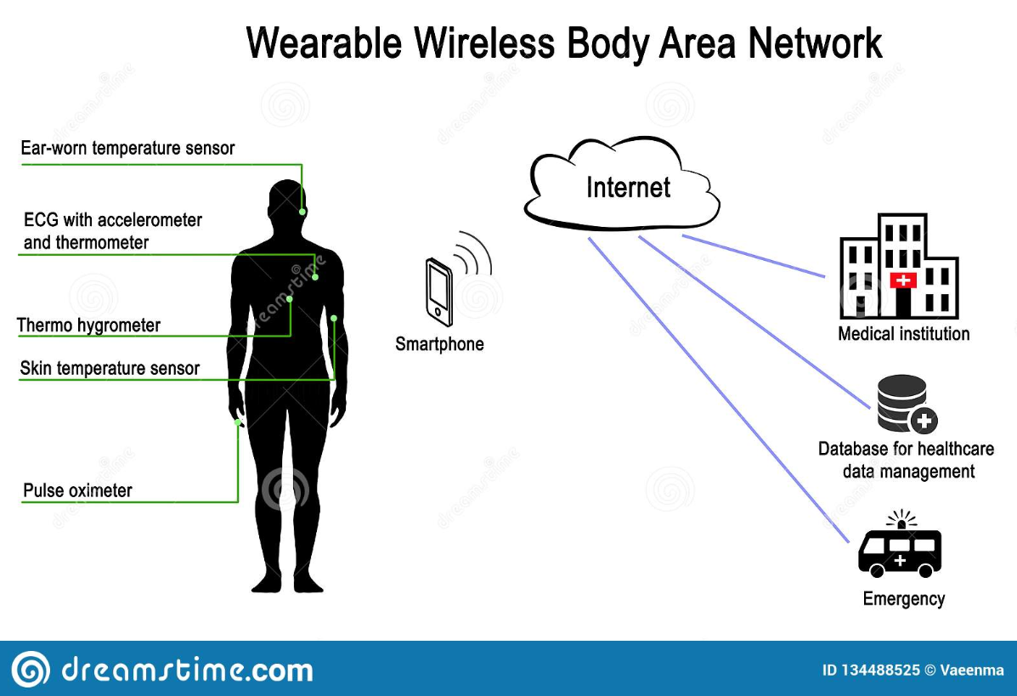
Body Sensor Networks ( BSNs )
BAN, WBAN, MBAN

Slide 10


Original BSN’s Problems
Monopoly Problem
Vulnerability Problem
Privacy Problem
Integrity Problem

Slide 11


Proposed BSN using Blockchain
A chain
B chain
Consensus
Algorithm
Monopoly Problem
Vulnerability Problem
Privacy Problem
Integrity Problem
Implantable
Device
Broadcast
Encrypt!
Gateway
Device
Wearable
Device

Slide 12
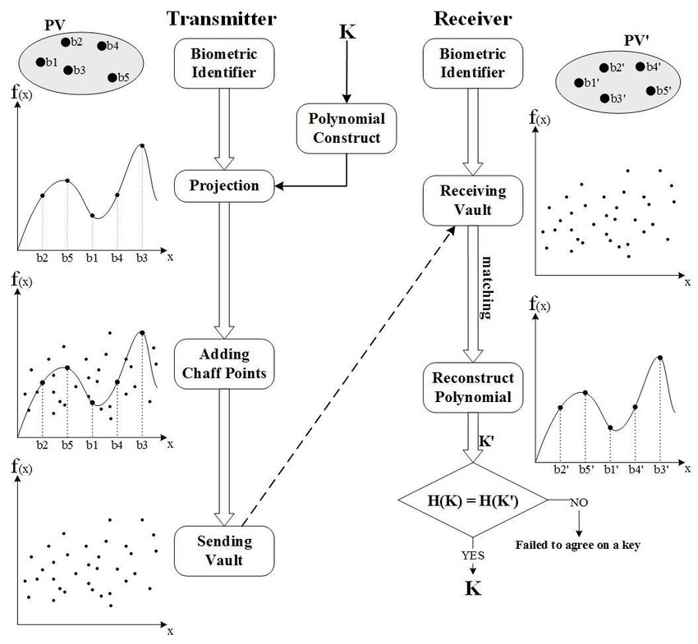
Fuzzy Vault

Slide 13
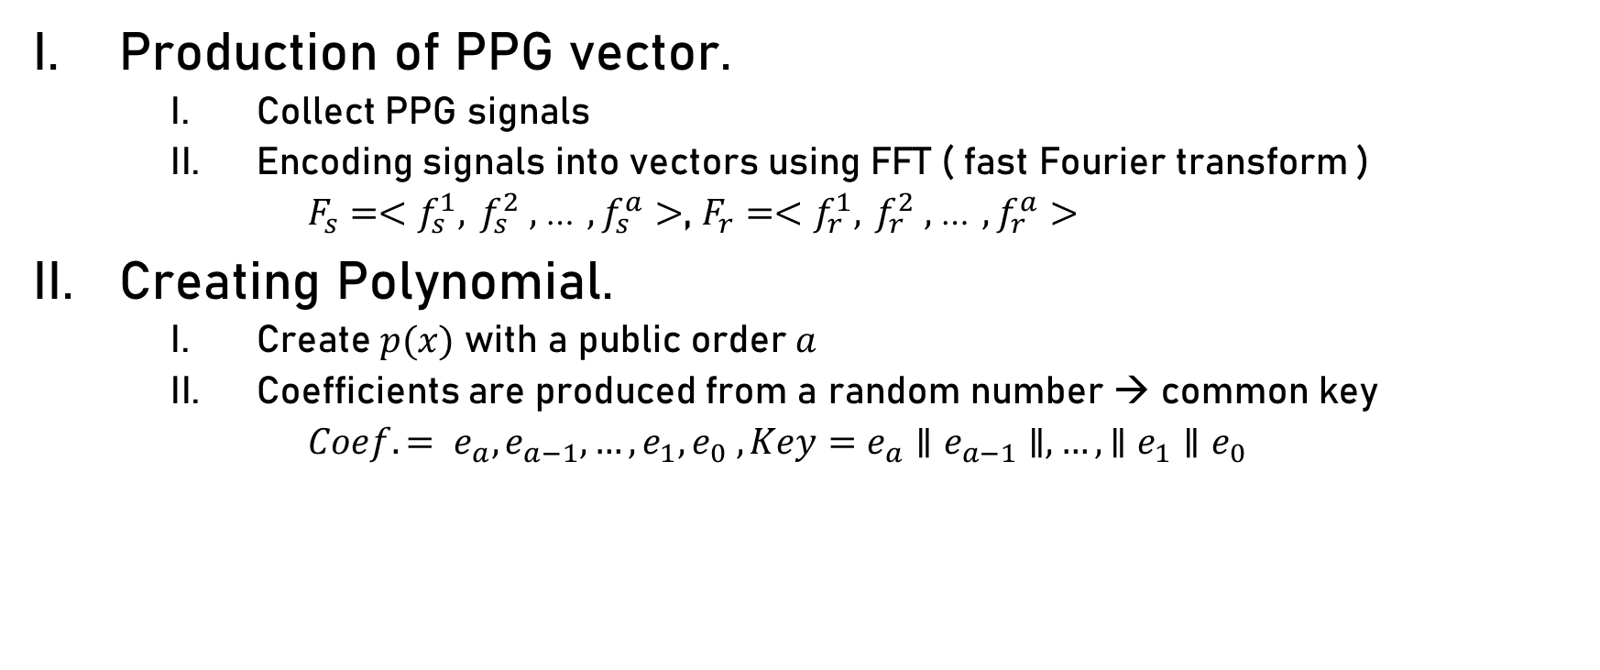
Fuzzy Vault using PPG ( photoplethysmography ) signal
Production of PPG vector.
Collect PPG signals
Encoding signals into vectors using FFT ( fast Fourier transform )
$F_{s}=<f_{s}^{1},$ $f_{s}^{2} ,$… $, f_{s}^{a}>$, $F_{r}=<f_{r}^{1},$ $f_{r}^{2} ,$… $, f_{r}^{a}>$
Creating Polynomial.
Create $p(x)$ with a public order $a$
Coefficients are produced from a random number → common key
$Coef. = e_{a}, e_{a−1}, …, e_{1}, e_{0} , Key=e_{a}∥e_{a−1}∥, …,∥e_{1}∥e_{0}$

Slide 14

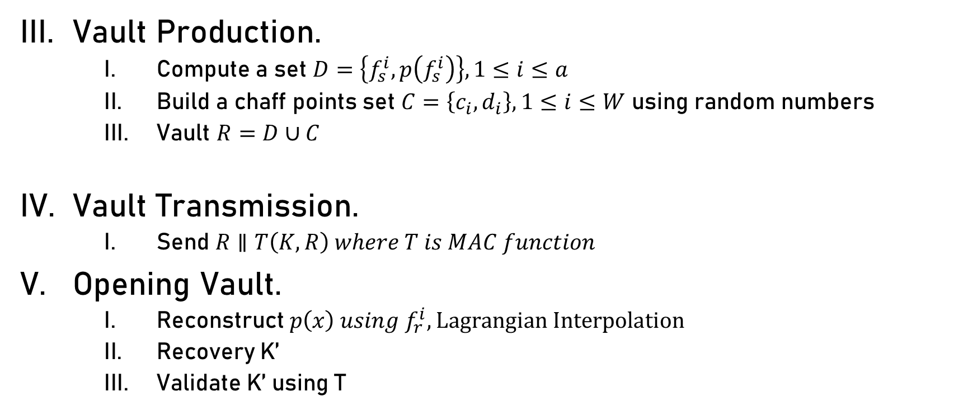
Fuzzy Vault using PPG ( photoplethysmography ) signal
Vault Production.
Compute a set $D=\left\{f_{s}^{i}, p\left(f_{s}^{i}\right)\right\}, 1≤i≤a$
Build a chaff points set $C=\left\{c_{i}, d_{i}\right\}, 1≤i≤W$ using random numbers
Vault $R=D∪C$
Vault Transmission.
Send $R∥T\left(K,R\right) where T is MAC function$
Opening Vault.
Reconstruct $p\left(x\right) using f_{r}^{i}, Lagrangian Interpolation$
Recovery K’
Validate K’ using T
predefined
$$≠p(c_{i})$$

Slide 15
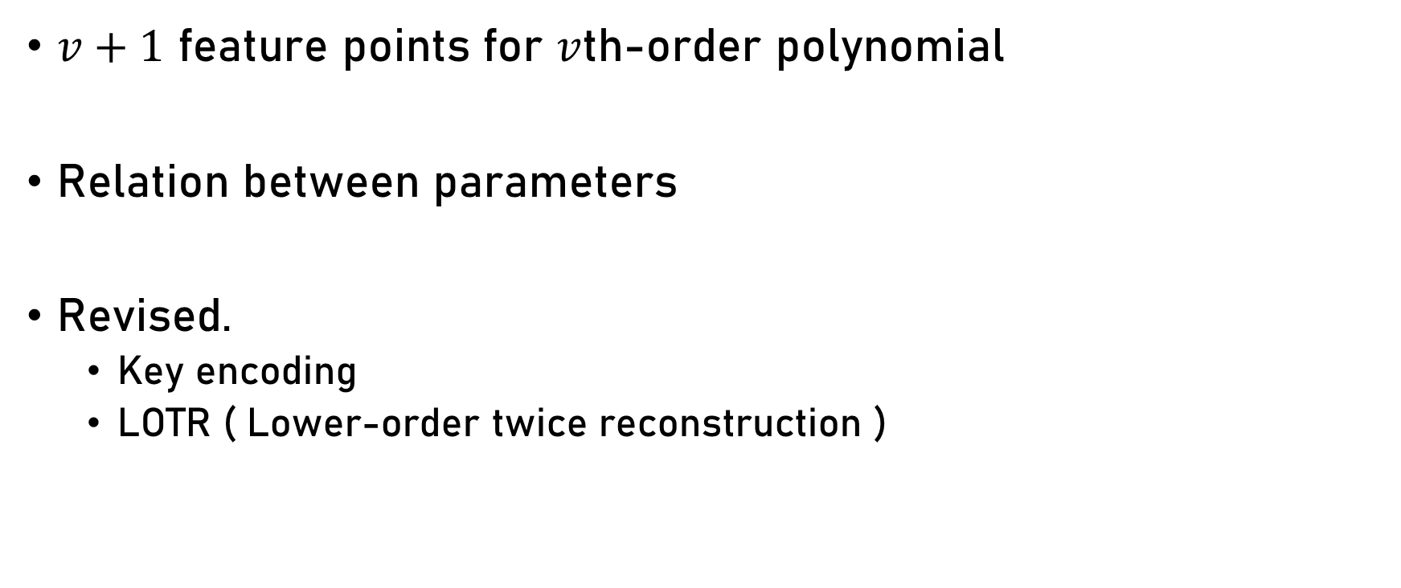
Fuzzy Vault using PPG signal problem
$v+1$ feature points for $v$th-order polynomial
Relation between parameters
Revised.
Key encoding
LOTR ( Lower-order twice reconstruction )

Slide 16
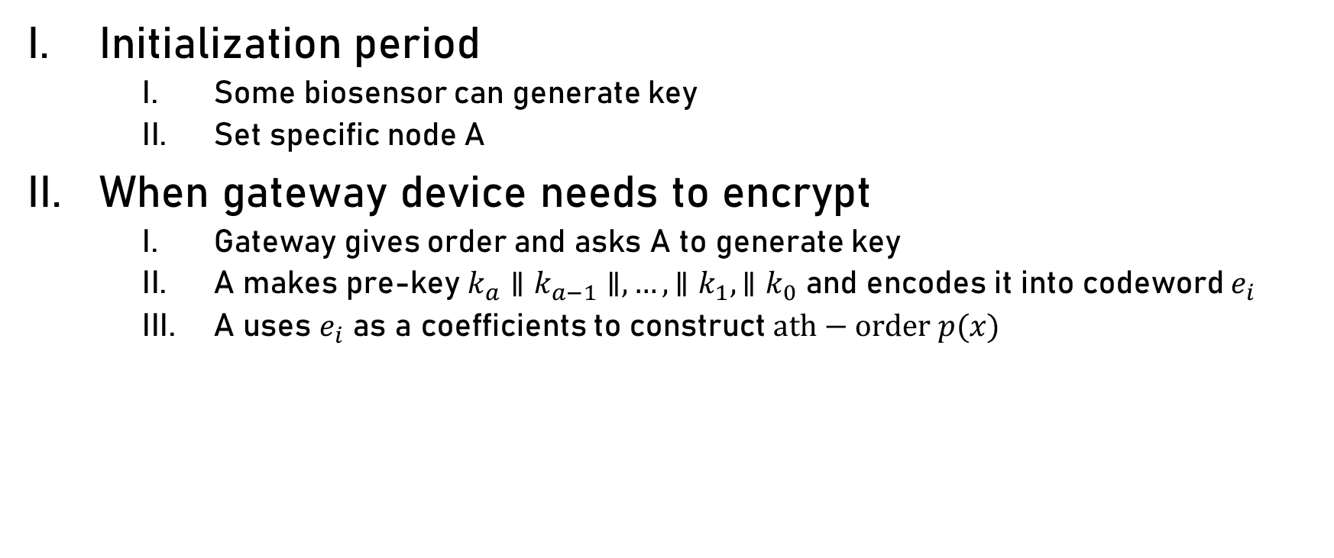
Proposed BSN again
Initialization period
Some biosensor can generate key
Set specific node A
When gateway device needs to encrypt
Gateway gives order and asks A to generate key
A makes pre-key $k_{a}∥k_{a−1}∥,…,∥k_{1},∥k_{0}$ and encodes it into codeword $e_{i}$
A uses $e_{i}$ as a coefficients to construct $ath−order p(x)$

Slide 17
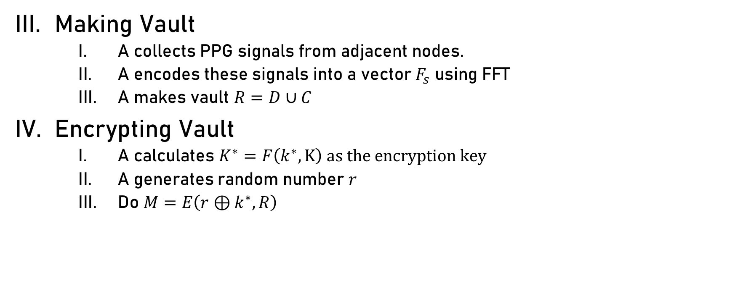
Proposed BSN again
Making Vault
A collects PPG signals from adjacent nodes.
A encodes these signals into a vector $F_{s}$ using FFT
A makes vault $R=D∪C$
Encrypting Vault
A calculates $K^{∗}=F\left(k^{∗},K\right) as the encryption key$
A generates random number $r$
Do $M=E\left(r⊕k^{∗}, R\right)$
Random function
Pre-distributed key

Slide 18
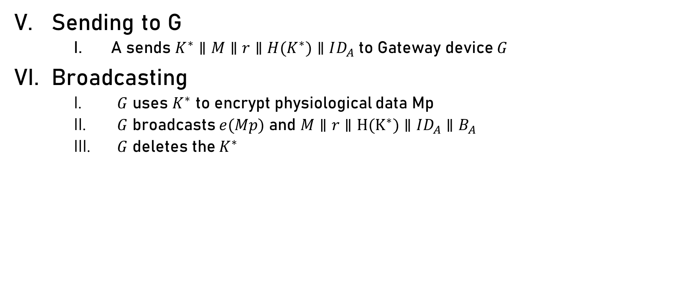
Proposed BSN again
Sending to G
A sends $K^{∗}∥M∥r∥H(K^{∗})∥ID_{A}$ to Gateway device $G$
Broadcasting
$G$ uses $K^{∗}$ to encrypt physiological data Mp
$G$ broadcasts $e(Mp)$ and $M∥r∥H(K^{∗})∥ID_{A}∥B_{A}$
$G$ deletes the $K^{∗}$

Slide 19

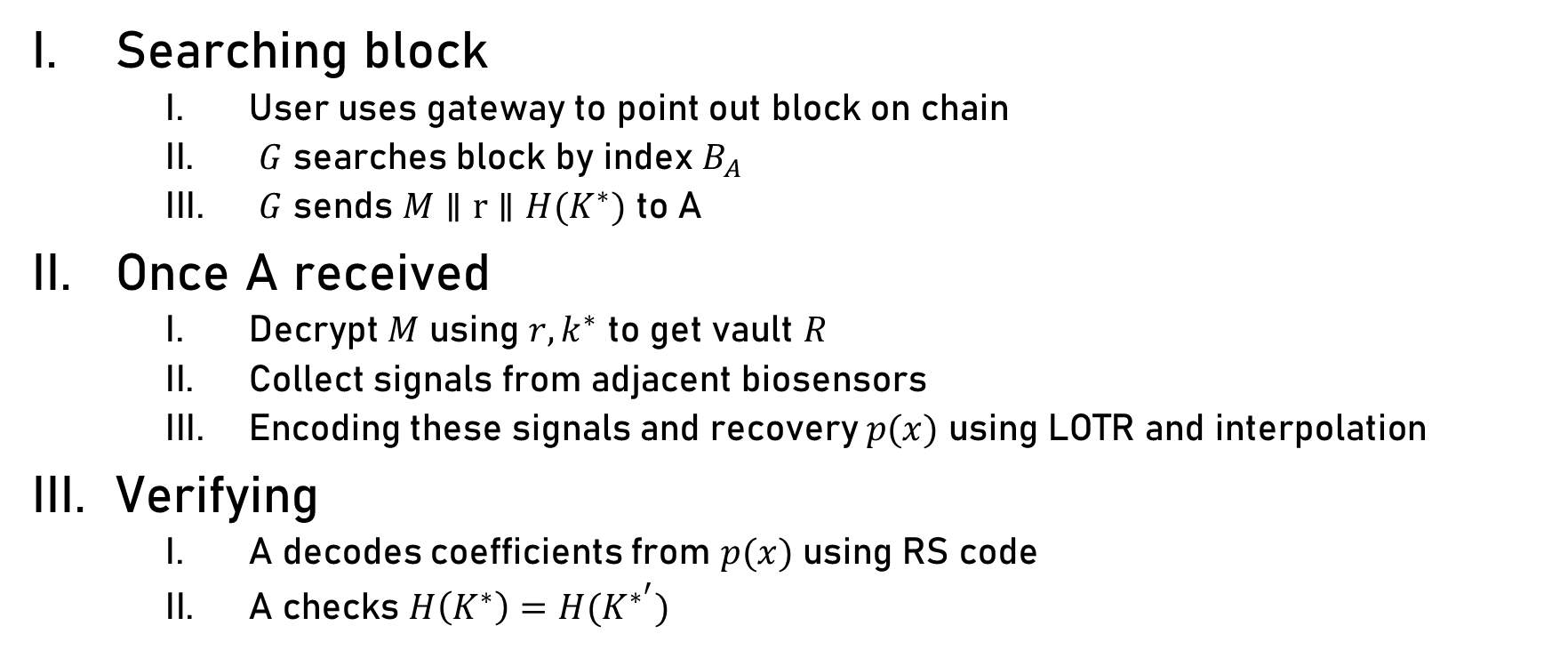
Proposed BSN again ( Recovering )
$e(Mp)$ and $M∥r∥H(K^{∗})∥ID_{A}∥B_{A}$
Searching block
User uses gateway to point out block on chain
$G$ searches block by index $B_{A}$
$G$ sends $M∥r∥H(K^{∗})$ to A
Once A received
Decrypt $M$ using $r, k^{∗}$ to get vault $R$
Collect signals from adjacent biosensors
Encoding these signals and recovery $p(x)$ using LOTR and interpolation
Verifying
A decodes coefficients from $p(x)$ using RS code
A checks $H\left(K^{∗}\right)=H(K^{∗^{′}})$

Slide 20


Security and performance analysis
Attacking the blockchain
Attacking the BSN
On or into the human body
Increase order
Performance
BSN nodes are in charge of generation, backup, recovery
$e(Mp)$ and $M∥r∥H(K^{∗})∥ID_{A}∥B_{A}$
$$R=D∪C$$

